Slide 1
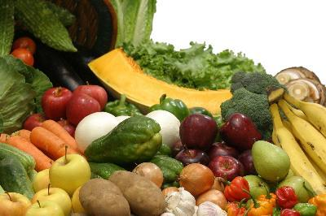
Human Nutritional Requirements
The essential nutrients for humans include protein, energy, carbohydrates, fats and lipids, a range of vitamins, and a host of minerals and trace elements.

Slide 2
Nutrients and their functions
Carbohydrates are the main energy source for the brain.
Sources include fruits, breads and grains, starchy vegetables and sugars. Make at least half of the grains you consume whole grains. Whole grains and fruit are full of fiber, which reduces the risk of coronary heart disease and helps maintain normal blood glucose levels.

Slide 3
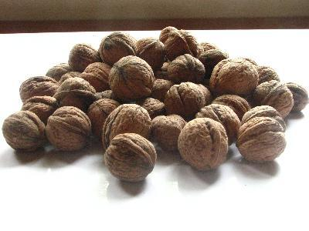
Fats
Fat is an energy source that when consumed, increases the absorption of fat-soluble vitamins including vitamins A, D, E and K.

Slide 4
Protein
Protein
Protein is the major structural component of cells and is responsible for the building and repair of body tissues. Protein is broken down into amino acids, which are building blocks of protein.
Sources of are meat, dairy, beans and eggs.

Slide 5
Vitamins
Vitamin C is necessary for the synthesis of collagen, which provides structure to blood vessels, bone and ligaments. Rich sources include citrus fruits, strawberries and peppers.
Vitamin D helps to maintain calcium homeostasis. It can be found in food sources or synthesized by the sun.

Slide 6
Minerals
Minerals
Sodium helps to maintain fluid volume outside of the cells and helps cells to function normally.

Slide 7
Potassium maintains fluid volume inside and outside of cells and prevents the excess rise of blood pressure with increased sodium intake. Rich sources include bananas, potatoes and tomatoes. Calcium helps to maintain and build strong bones and teeth.

Slide 8
Water
Water helps to maintain homeostasis in the body and transports nutrients to cells. Water also assists in removing waste products from the body. All beverages and high-moisture foods such as soup and watermelon contain water and count towards your daily water requirement.

Slide 9
What is agriculture?
This is the science or practice of farming, including cultivation of the soil for the growing of crops and the rearing of animals to provide food, wool, and other products.

Slide 11
The ‘Green Revolution’
The term Green Revolution refers to the renovation of agricultural practices beginning in Mexico in the 1940s. Because of its success in producing more agricultural products there, Green Revolution technologies spread worldwide in the 1950s and 1960s, significantly increasing the amount of calories produced per acre of agriculture.

Slide 12
History and Development of the Green Revolution
The beginnings of the Green Revolution are often attributed to Norman Borlaug, an American scientist interested in agriculture. In the 1940s, he began conducting research in Mexico and developed new disease resistance high-yield varieties of wheat.

Slide 13
History and Development of the Green Revolution
By combining Borlaug's wheat varieties with new mechanized agricultural technologies, Mexico was able to produce more wheat than was needed by its own citizens, leading to its becoming an exporter of wheat by the 1960s.

Slide 14
History and Development of the Green Revolution
Prior to the use of these varieties, the country was importing almost half of its wheat supply.
Due to the success of the Green Revolution in Mexico, its technologies spread worldwide in the 1950s and 1960s. The United States for instance, imported about half of its wheat in the 1940s but after using Green Revolution technologies, it became self-sufficient in the 1950s and became an exporter by the 1960s.

Slide 15
India for example was on the brink of mass famine in the early 1960s because of its rapidly growing population. Borlaug and the Ford Foundation then implemented research there and they developed a new variety of rice, IR8, that produced more grain per plant when grown with irrigation and fertilizers. Today, India is one of the world's leading rice producers and IR8 rice usage spread throughout Asia in the decades following the rice's development in India.

Slide 16
Plant Technologies of the Green Revolution
The crops developed during the Green Revolution were high yield varieties - meaning they were domesticated plants bred specifically to respond to fertilizers and produce an increased amount of grain per acre planted.

Slide 17
Impacts of the Green Revolution
Since fertilizers are largely what made the Green Revolution possible, they forever changed agricultural practices because the high yield varieties developed during this time cannot grow successfully without the help of fertilizers.

Slide 18
Impacts of the Green Revolution
Irrigation also played a large role in the Green Revolution and this forever changed the areas where various crops can be grown. For instance before the Green Revolution, agriculture was severely limited to areas with a significant amount of rainfall, but by using irrigation, water can be stored and sent to drier areas, putting more land into agricultural production - thus increasing nationwide crop yields.

Slide 19
Impacts of the Green Revolution
Finally, the use of Green Revolution technologies exponentially increased the amount of food production worldwide. Places like India and China that once feared famine have not experienced it since implementing the use of IR8 rice and other food varieties.

Slide 20
Criticism of the Green Revolution
The first is that the increased amount of food production has led to overpopulation worldwide.

Slide 21
Criticism of the Green Revolution
The second major criticism is that places like Africa have not significantly benefited from the Green Revolution. The major problems surrounding the use of these technologies here though are a lack of infrastructure, governmental corruption, and insecurity in nations.

Slide 22
Criticism of the Green Revolution
Despite these criticisms though, the Green Revolution has forever changed the way agriculture is conducted worldwide, benefiting the people of many nations in need of increased food production.

