Slide 1
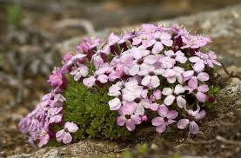
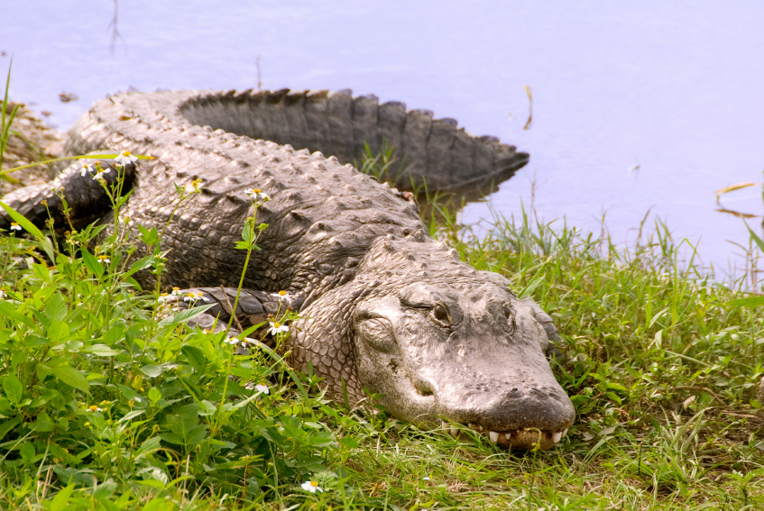
KEYSTONE SPECIES
A keystone species is a plant or animal that plays a unique and crucial role in the way an ecosystem functions. Without keystone species, the ecosystem would be dramatically different or cease to exist altogether.

Slide 2
The theory that the balance of ecosystems can rely on one keystone species was first established in 1969 by American zoology professor Robert T. Paine. Paine's research showed that removing one species, the Pisaster ochraceus sea star, from a tidal plain on Tatoosh Island in the U.S. state of Washington, had a huge effect on the surrounding ecosystem. The sea stars are a major predator for mussels on Tatoosh Island. With the sea stars gone, mussels took over the area and crowded out other species. In this ecosystem, the sea star was the keystone species.

Slide 3
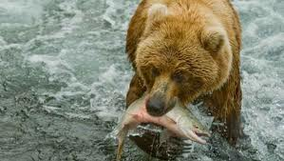
All species in an ecosystem, or habitat, rely on each other. The contributions of a keystone species are large compared to the species' prevalence in the habitat. A small number of keystone species can have a huge impact on the environment.

Slide 4
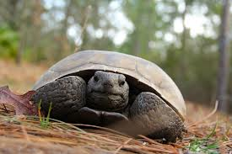
A keystone species is often, but not always, a predator. A few predators can control the distribution and population of large numbers of prey species. A single mountain lion near the Mackenzie Mountains in Canada, for example, can roaman area of hundreds of kilometers. The deer, rabbits, and bird species in the ecosystem are at least partly controlled by the presence of the mountain lion. Their feeding behavior, or where they choose to make their nests and burrows, are largely a reaction to the mountain lion's activity. Scavenger species, such as vultures, are also controlled by the activity of the mountain lion.

Slide 5
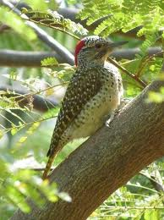
A keystone species' disappearance would start a domino effect. Other species in the habitat would also disappear and become extinct. The keystone species' disappearance could affect other species that rely on it for survival. For example, the population of deer or rabbits would explode without the presence of a predator. The ecosystem cannot support an unlimited number of animals, and the deer soon compete with each other for food and water resources. Their population usually declines without a predator such as a mountain lion.

Slide 6
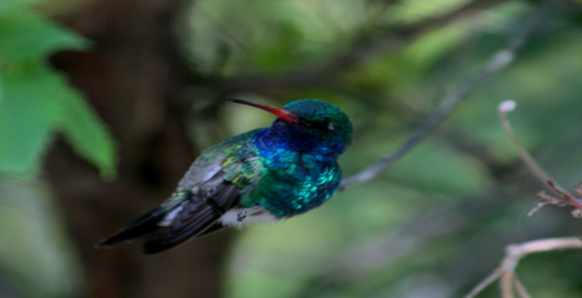
Without the keystone species, new plants or animals could also come into the habitat and push out the native species. Some species of hummingbirds are keystone species in the Sonoran Desert of North America. Hummingbirds pollinate many varieties of native cactus and other plants. In areas of the Sonoran Desert with few hummingbirds, invasive species such as buffel grass have taken over the ecosystem.

Slide 7
Elephants are keystone species on African grasslands, known as savannas. Without the presence of elephants, grasslands would probably develop into forests. Elephants graze on trees such as acacias, above, preventing them from growing to maturity.

Slide 8
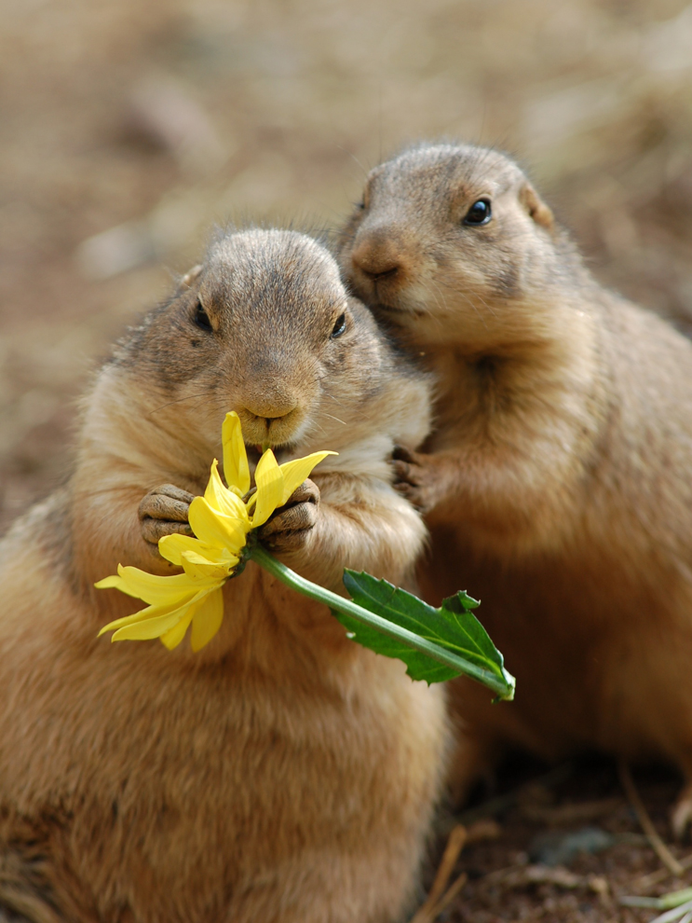
Prairie dogs are a keystone species, a species whose very presence contributes to the existence of the ecosystem in which it lives. Prairie dogs contribute to the soil and water quality in their plains ecosystem. Their foraging retains water in the soil and forces fresh new grasses to continually grow. Young grasses have more nutrients for species such as bison and elk.

Slide 9
Sea otters, like this mother and pup, are one of the most important keystone species in the kelp forest habitat. Kelp, a giant species of seaweed, is home to hundreds of species, from sea stars to sharks. Sea urchins eat kelp. Sea otters eat sea urchins, preventing an overpopulation of urchins from destroying the ecosystem.

Slide 10
Keystone species are often predators, like this mountain lion in Glacier National Park, Wyoming. The deer, rabbits, and bird species in the ecosystem are at least partly controlled by the presence of the mountain lion. Their feeding behavior, or where they choose to make their nests and burrows, is largely a reaction to the mountain lion’s activity.

