Slide 1
Energy Resources and Consumption
Energy Forms
Energy comes in two basic forms:
1. Potential Energy is any type of stored energy; it isn’t shown through movement. Potential energy can be chemical, nuclear, gravitational, or mechanical.
2. Kinetic Energy is the energy of movements: the motion of objects (from people to planets), the vibrations of atoms by sound waves or in thermal energy (heat), the electromagnetic energy of the movements of light waves, and the motion of electrons in electricity.

Slide 2
Each form of energy can be transformed into any of the other forms, but energy isn’t destroyed or created. Losses of energy can always be accounted for by small transformations to other types of energy, like sound and heat. Power plants convert potential energy or kinetic energy into electricity, a type of kinetic energy, and electricity in turn can be converted back into other forms of energy, like heat in an oven or light from a lamp.
`

Slide 3
Forms of Potential Energy
CHEMICAL
Chemical energy is stored in the bonds between atoms. (See here for more about atoms.) This stored energy is released and absorbed when bonds are broken and new bonds are formed — chemical reactions. Chemical reactions change the way atoms are arranged. Like letters of the alphabet that can be rearranged to form new words with very different meanings, atoms go through chemical reactions to be reorganized to form new compounds with vastly different properties. Each compound has its own chemical energy associated with the bonds between the atoms it contains.
When we burn sugar (a compound made of hydrogen, oxygen, and carbon) during exercise, it’s components are reorganized into water (H2O) and carbon dioxide (CO2). These reactions both absorb and release energy, but the net reaction releases energy.
Chemical reactions that produce net energy are called exothermic. When gasoline is burned, the reactions taking place are exothermic and thermal energy is released, which can be used to power an engine. Meanwhile, chemical reactions that absorb net energy are called endothermic.

Slide 4
NUCLEAR energy
Nuclear energy is the stored potential of the nucleus, or center, of an individual atom. Most atoms are stable on Earth; they retain their identities as particular elements, like hydrogen, helium, iron, and carbon, as identified in the Periodic Table of Elements. Nuclear reactions change the fundamental identity of elements.
Unlike everyday chemical reactions that change how atoms are stuck together (rearranging the letters of a word), nuclear reactions change the name of the atoms themselves. (Sort of as if the letter “m” was split into the letters “r” and “n,” or the letters “l” and “o” combined to make the letter “b”). In nuclear reactions, atoms split apart or join together to form new kinds of atoms, called fission and fusion, respectively.
When atoms split apart or fuse together, they release stored nuclear energy, sometimes in huge quantities.
Today’s nuclear power plants are fueled by fission, a breaking apart of uranium or plutonium atoms that releases lots of energy. Hydrogen atoms in the sun experience nuclear fusion, combining to form helium and subsequently releasing large amounts of kinetic energy in the form of electromagnetic radiation and heat.

Slide 5
Elastic energy
ELASTIC
Elastic energy can be stored mechanically in a compressed gas or liquid, a coiled spring, or a stretched elastic band. On an atomic scale, the basis for the energy is a reversible strain placed on the bonds between atoms, meaning there’s no permanent change to the material.
These bonds absorb energy as they are stressed, and release that energy as they are relaxed.

Slide 6
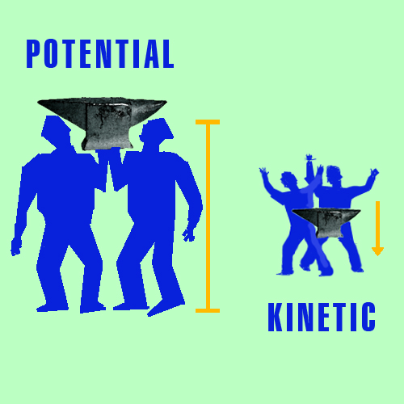
GRAVITATIONAL

Slide 7
Systems can build up gravitational energy as mass moves away from the center of Earth or other objects that are large enough to generate significant gravity (the sun, other planets and stars).
For example, the farther you lift an anvil away from the ground, the more potential energy it gains. The energy used to lift the anvil is called work, and the more work performed, the more potential energy the anvil gains. If the anvil is dropped, that potential energy becomes kinetic energy as the anvil moves faster and faster toward Earth.

Slide 8
Forms of Kinetic Energy
MOTION
A moving object has kinetic energy. A basketball passed between players shows translational energy in the motion that gets the ball from player A to player B. That kinetic energy is proportional to the ball’s mass and the square of its velocity. To throw the same ball twice as fast, a player uses four times the energy.
If a player shoots a basketball with backspin or topspin, the basketball will also have rotational energy as it spins through the air. Rotational energy is proportional to how quickly the ball spins, as well as the ball’s mass, and the size and shape of the ball. A hollow ball needs more energy than a solid ball of equal mass to spin at the same rate. The hollow ball requires more energy because it’s mass is farther from its center.

Slide 9
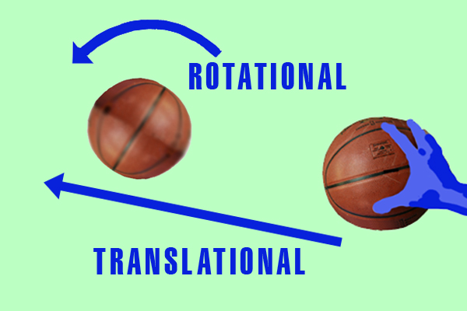
In shooting a basketball, players often try to add rotational energy as backspin, because it results in the greatest slowdown in speed when the basketball hits the rim or the backboard, increasing the chance that the ball stays near the basket. The opposite direction of spin, a topspin, can be used in games like tennis, because it will help speed up a ball after impact and lowers the angle it travels after the bounce.

Slide 10
THERMAL ENERGY AND TEMPERATURE
Heat and thermal energy are directly related to temperature. We can’t see individual atoms vibrating, but we can feel their kinetic energies as temperature, which is a reflection of the energy with which atoms vibrate. When there’s a difference between the temperature of the environment and a system within it, thermal energy is transferred between them as heat.
A hot cup of tea in a cool room loses some of its thermal energy as heat flows from the tea to the room. The atoms in the hot tea slow their vibrating as the tea loses heat, and over a few hours the tea cools to the same temperature as the room. At the same time, the room gains the lost thermal energy from the tea, but because the room is much larger than the tea, the temperature of the room increases by so little a person wouldn’t notice it.

Slide 11
SOUND ENERGY
Sound waves are made through the transmitted vibration of atoms in bulk — though atoms can also vibrate through heat — and sound can travel by the motion of atoms regardless of whether they are in liquid, solid, or gaseous states. Sound cannot travel in a vacuum because a vacuum has no atoms to transmit the vibration.
Solids, liquids, and gases transmit sounds as waves, but the atoms that pass along the sound don’t travel (unlike the photons in light). The sound wave travels between atoms, like people passing along a “wave” in a sports stadium. Sounds have different frequencies and wavelengths (related to pitch) and different magnitudes (related to how loud).
Even though radio waves can transmit information about sound, they are a completely different kind of energy, called electromagnetic.

Slide 12
ELECTROMAGNETIC RADIATION
Electromagnetic energy is the same as radiation or light energy. This type of kinetic energy can take the form of visible light waves, like the light from a candle or a light bulb, or invisible waves, like radio waves, microwaves, x-rays and gamma rays. Radiation — whether it’s coming from a candle or nuclear fission of uranium — can travel in a vacuum, and physicists like to think of electromagnetic radiation as divided into tiny energy packets called photons. Each photon has a characteristic frequency, wavelength, and energy, but all photons travel at the same speed, the speed of light, or nearly 1 billion feet per second.
Electromagnetic energy can be converted to stored chemical energy by plants during photosynthesis, the process by which plants, algae, and some other small organisms use the sun’s electromagnetic radiation to turn carbon dioxide gas into sugar and carbohydrates.

Slide 13
Electromagnetic energy can be converted to stored chemical energy by plants during photosynthesis, the process by which plants, algae, and some other small organisms use the sun’s electromagnetic radiation to turn carbon dioxide gas into sugar and carbohydrates.

Slide 14
Electric energy
Electric energy is to the kinetic energy of moving electrons, the negatively-charged particles in atoms. For more information about electricity, see Basics of Electricity.

Slide 15
What is the difference between energy and power?
People always seem to consider Energy and Power to be the same. They even make the mistake of thinking ‘Energy and Power’ as synonyms. Well, one cannot even be blamed of finding a similarity between Energy and Power as they are interrelated.
It is not that difficult to distinguish between Energy and power. While energy is the ability to do work, Power is its measurement, which calculates the time by which the energy has been used. Well, Energy is what one delivers and Power is the rate at which it is delivered.
Energy is the capability to do something. For example, energy is used for moving the car or heating the home or lighting the night or even flying an aeroplane. The basic unit of Energy is Joule but normally it is termed in watt-hour or kilowatt-hour. Energy appears in many forms and is often expressed in multiple units.

Slide 16
Coming to power, it is rate of Energy per unit of time. Power is the capacity of energy, which is being used. In more simple terms, power is defined as the rate of doing work. Power finds it use in mechanical applications, heat applications, electrical applications and several other areas.
Let us see an example of a weight lifter to understand Energy and Power more precisely. Power is like the strength of a weight lifter and Energy is the measure of how long he can sustain the output of power. While energy is ‘joules’, power is ‘joules per second’. Well, in another words Power is ‘watt’ and Energy is ‘watt-hour’.

Slide 17
Another difference is that energy can be stored whereas power cannot be stored. While energy comes with a time component, Power is an instantaneous quantity. Power cannot vary but remains constant. Meanwhile energy accumulates predictably.
Energy changes form but power doesn’t change form. If something has to happen, Energy has to change form. But Power only measures how fast the change has happened; Power is the rate at which the energy has been converted every second.

